Slide 1
First approach : different algorithms for train pictures
BURGUÉS Gerard
ROGIE Elliot

Slide 2
SIFT : Scale Invariant Feature Transform
4 steps:
Constructing a Scale Space
Keypoint Localisation
Orientation Assignment
Keypoint Descriptor
Notes:
https://www.analyticsvidhya.com/blog/2019/10/detailed-guide-powerful-sift-technique-image-matching-python/

Slide 3
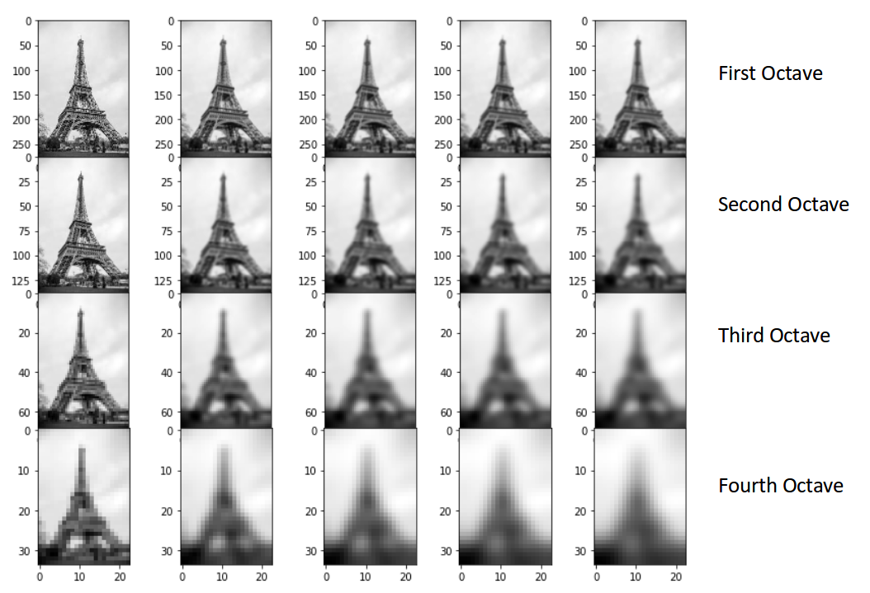
SIFT : Constructing a Scale Space
Divide by 2 the number of pixel (4 time)
Made different level of blur
Use Difference of Gaussian for each octave.
Goal :
Reduce the noise of the picture
Unscale picture

Slide 4
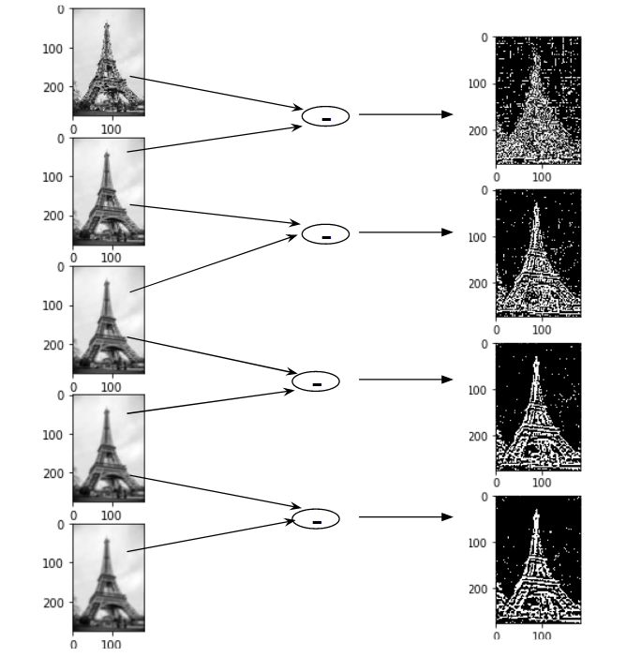
SIFT : Constructing a Scale Space

Slide 5
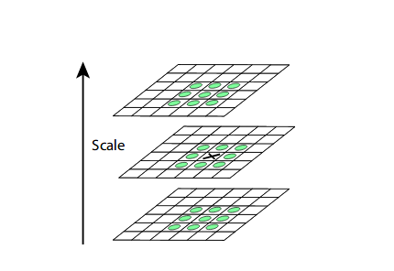
SIFT : Keypoint Localisation
Select extreme contrast point between the 26 pixels around a point (8 point for the picture analysed and 18 for the picture of the octave
Second selection with two tests : low contrast and border
Notes:
a second-order Taylor expansion is computed for each keypoint (test low contrast)
Border : eliminate keypoint if there are to close to the picture border

Slide 6
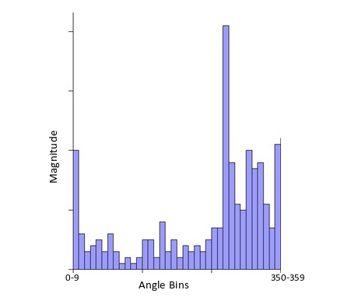
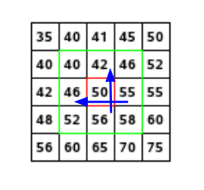
SIFT : Orientation Assignment
For each keypoint, we calculate different the magnitude and the angle.
Made a histogram of all vector of the pixel around the keypoint and the vector of the key point depend of this histogram (show the peak
Notes:
Magnitude = √[(G_{x})²+(G_{y})²]
Φ = atan(Gy / Gx)
I dont understand what is the histogram

Slide 7
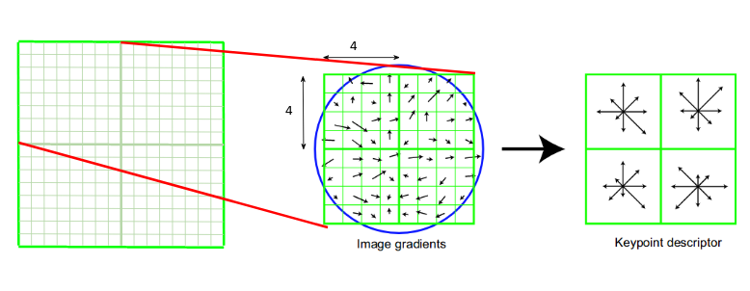
SIFT : Keypoint Descriptor
For each key point make a fingerprint. That mean to have information of the neighbour direction and magnitude

Slide 8
LBPH (Local Binary Patterns Histograms) face recognizer
Condition of working :
Only face pictures (so face detection is already done)
Same size
3 steps:
LBP operations
Extracting histogram
Histogram Compare
Notes:
https://towardsdatascience.com/face-recognition-how-lbph-works-90ec258c3d6b

Slide 9
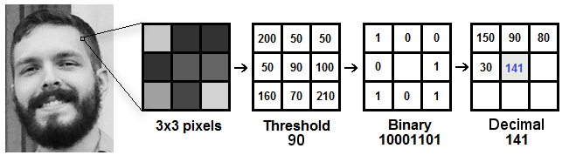
LBPH : LBP operations
Transform the picture to see easily highlighting the facial characteristics .
Choose the radius and the number of neighbour
Transform the neighbour into binary (if the intensity is < of the point put 0 else put 1)

Slide 10
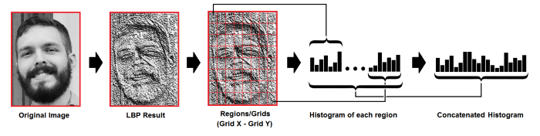
LBPH : Extracting histogram
Divide the picture by grid
For each grid, make an histogram with the occurrence of difference intensity.
Concatenate all histogram

Slide 11
LBPH : Histogram
In this step, you have plenty of histogram (depends of the train data)
With a test picture:
Make the histogram
Find the closest histogram with train data
euclidean distance, chi-square, absolute value methods

Slide 12
Fisher face recognizer
Based on linear discriminant analysis (LDA)
Fisherface method is designed to recognize the face image by matching the results of its feature extraction. The system is expected to determine wether the image to be tested is recognized correctly or not.

Slide 13
Fisher face recognizer
Step 1 : Retreive data
Collection of data is done in form of face images . Collection can be done using photographs already saved or from a webcam. Face must be fully visible and must be facing forward.
Step 2 : Image Processing
a) Preprocessing stage : Getting images using camera or saved images and conversion from RGB to grayscale. Image data is divided into training and test data.
b) Processing stage : Fisherface method will be applied to generate feature vector of facial image data used by system and then to match vector of traits of training image with vector characteristic of test image using euclidean distance formula
Step 3 : Feature generation
Features of the faces are extracted.
Notes:
Scatter Matrix :A scatter matrix is a estimation of covariance matrix when covariance cannot be calculated or costly to calculate. The scatter matrix is also used in lot of dimensionality reduction exercises
covariance is a measure of the joint variability of two random variables.^{[1]} If the greater values of one variable mainly correspond with the greater values of the other variable, and the same holds for the lesser values, (i.e., the variables tend to show similar behavior), the covariance is positive.

Slide 14
Thank you for your atention

